Slide 1


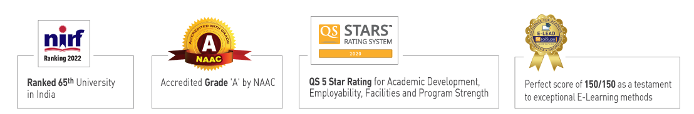

Slide 2

Unit 1 : Introduction
Lecture 4: Intelligent agents, Nature of agents, Learning agents
Submitted by: Dr Mohd Mustaqeem
School of Computer Science UPES, Dehradun
India

Slide 3
Table of Contents
1. Intelligent Agents
2. Characteristics
3. Types of Intelligent Agents
4. Environment types
5 Agents functions and Program
6 Learning Agents
7 Learning types
8 Learning Techniques
9 AI Techniques

Slide 4
Learning & Course Outcomes
LO1: Understand the definition and working of Learning Agents.
LO2: Understand about different learning techniques.
CO1: Understand the basic concepts and techniques of Artificial Intelligence.

Slide 5
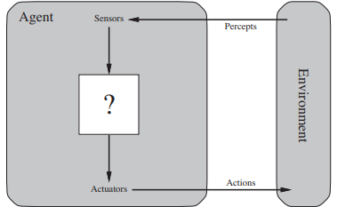
Intelligent Agents
An agent is anything that can be viewed as perceiving its environment through sensors and acting upon that environment through actuators.

Slide 6
Intelligent Agents
Example: A human agent has eyes, ears, and other organs for sensors and hands, legs, vocal tract, and so on for actuators.
A robotic agent might have cameras and infrared range finders for sensors and various motors for actuators.
A software agent receives keystrokes, file contents, and network packets as sensory inputs and acts on the environment by displaying on the screen, writing files, and sending network packets.

Slide 7
Characteristics:
Autonomy: Operate without human intervention.
Social Ability: Interact with other agents or humans.
Reactivity: Perceive their environment and respond in a timely fashion to changes.
Proactivity: Take initiative to fulfill their goals by exhibiting goal-directed behavior.

Slide 8
Types of Intelligent Agents:
Simple Reflex Agents: Act based solely on the current percept, ignoring the rest of the percept history.
Model-Based Reflex Agents: Use an internal state to keep track of the part of the world they can't see, providing a model of the world.
Goal-Based Agents: Act to achieve goals, requiring goal information in addition to the current state description.
Utility-Based Agents: Choose actions based on a utility function, which maps a state (or sequence of states) to a measure of the agent’s happiness.

Slide 9
Environment Types I:
Fully Observable vs. Partially Observable: In fully observable environments, the agent's sensors give it access to the complete state of the environment. In partially observable environments, the agent's sensors provide incomplete information.
Deterministic vs. Stochastic: In deterministic environments, the next state of the environment is completely determined by the current state and the action executed by the agent. In stochastic environments, there are elements of randomness.

Slide 10
Environment Types II:
Episodic vs. Sequential: In episodic environments, the agent’s experience is divided into atomic episodes. In sequential environments, current actions affect future actions.
Static vs. Dynamic: Static environments do not change while the agent is deliberating. Dynamic environments can change.
Discrete vs. Continuous: Discrete environments have a finite number of states. Continuous environments have a range of values.

Slide 11
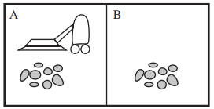
Agent Functions and Programs:
Agent Function: Maps a sequence of percepts to actions.
Agent Program: The implementation of the agent function, typically through algorithms and data structures.
Example: A vacuum-cleaner world with just two locations.

Slide 12
In general, an agent’s choice of action at any given instant can depend on the entire percept sequence observed to date, but not on anything it hasn’t perceived.
Percept Sequence | Action
[A, Clean] | Right
[A, Dirty] | Siphon
[A, Clean] | Left
[A, Dirty] | Siphon
[A, Clean], [A, Clean] | Right
[A, Clean], [A, Dirty] | Siphon
: | :
[A, Clean], [A, Clean], [A, Clean] | Right
[A, Clean], [A, Clean], [A, Dirty] | Siphon
: | :

Slide 13
Learning Agents
Components:
Learning Element: Responsible for making improvements.
Performance Element: Responsible for selecting external actions.
Critic: Provides feedback on the agent's performance.
Problem Generator: Suggests actions that will lead to new and informative experiences.

Slide 14
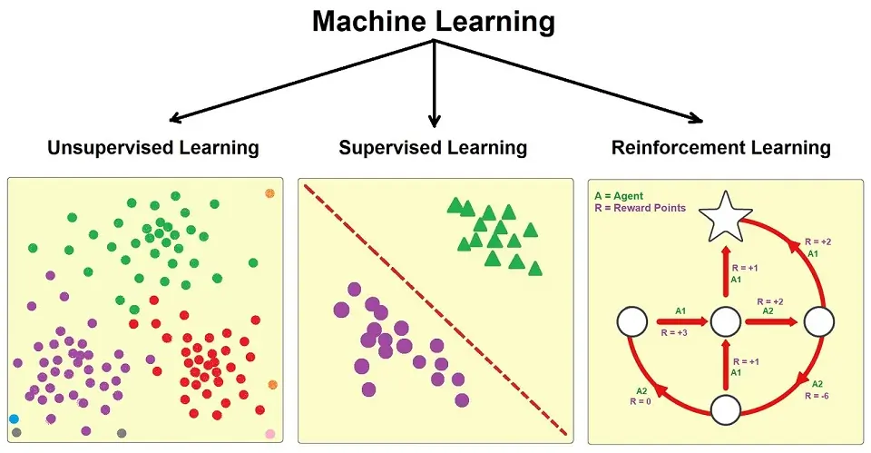
Learning Types

Slide 15
Learning Types
Supervised Learning: Learning from labeled training data.
Unsupervised Learning: Learning patterns in unlabeled data.
Reinforcement Learning: Learning by receiving rewards or penalties based on actions taken.
Semi-supervised Learning: Combination of labeled and unlabeled data.

Slide 16
Learning Techniques
Neural Networks: Learning patterns through simulated networks of neurons.
Decision Trees: Making decisions based on a tree-like model of decisions and their possible consequences.
Genetic Algorithms: Optimization techniques inspired by natural selection.
Q-Learning: A model-free reinforcement learning algorithm to learn the value of an action in a particular state.

Slide 17
AI Techniques
Search Algorithms:
Uninformed Search: Algorithms like BFS (Breadth-First Search) and DFS (Depth-First Search) that do not have additional information about states beyond that provided in the problem definition.
Informed Search: Algorithms like A* and Greedy Best-First Search that use heuristics to estimate the cost of reaching the goal.
f(n) = g(n) + h(n)

Slide 18
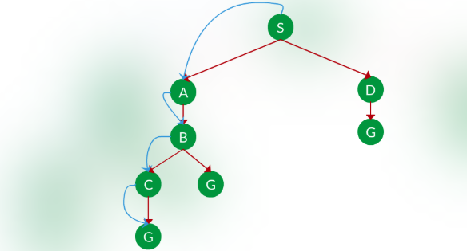
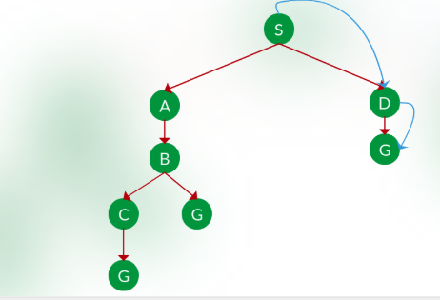
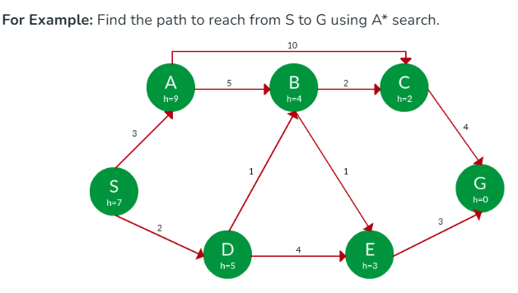
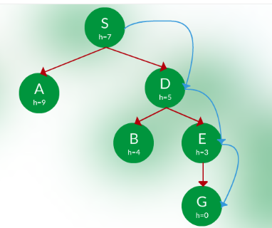
DFS (Depth-First Search)
BFS (Breadth-First Search)
Greedy Best-First Search
A*

Slide 19
AI Techniques
Optimization Algorithms:
Genetic Algorithms: Use mechanisms inspired by biological evolution, such as selection, crossover, and mutation.
Simulated Annealing: Probabilistic technique for approximating the global optimum of a given function.
Gradient Descent: Optimization algorithm used for minimizing the cost function in various machine learning algorithms.

Slide 20
AI Techniques
Knowledge Representation:
Logic: Using propositional and first-order logic to represent knowledge.
Semantic Networks: Graph structures for representing knowledge in patterns of interconnected nodes and arcs.
Frames: Data structures for dividing knowledge into substructures by representing stereotyped situations.
Notes:
Example (Propositional Logic):
"It is raining" → True/False
"If it is raining, then the ground is wet.“
Semantic Networks
Knowledge is represented as a graph with nodes (objects/concepts) and edges (relationships).
Example: A semantic network for animals:
Animal | is_a | Bird ------ can → Fly | is_a | Penguin ---- cannot → Fly
"Bird is an Animal"
"Birds can Fly"
"Penguin is a Bird“
From this, the system knows Penguin is an Animal but cannot fly.
Semantic networks are like mind maps — easy to visualize and connect concepts.
Frames
Think of frames like data tables (templates) that represent typical situations or objects.
They have slots (attributes) and values.
Example (Frame for a Car):
Frame: Car - Wheels: 4 - Fuel: Petrol/Diesel/Electric - Max-Speed: 200 km/h - Brand: Toyota

Slide 21
AI Techniques
Machine Learning Algorithms:
Supervised Learning Algorithms: Such as linear regression, logistic regression, SVM, and k-NN.
Unsupervised Learning Algorithms: Such as k-means clustering, hierarchical clustering, and PCA.
Reinforcement Learning Algorithms: Such as Q-learning and policy gradient methods.

Slide 22
MCQs
1. What defines an intelligent agent in AI?
A) An entity that operates solely based on pre-programmed instructions.
B) An entity that observes and acts upon an environment to achieve specific goals autonomously.
C) A software that performs repetitive tasks without learning.
D) A hardware device with pre-defined actions.
2. Which of the following is NOT a characteristic of intelligent agents?
A) Autonomy
B) Reactivity
C) Social ability
D) Manual control

Slide 23
MCQs
3. Which type of agent uses an internal model to keep track of the world?
A) Simple Reflex Agent
B) Model-Based Reflex Agent
C) Goal-Based Agent
D) Utility-Based Agent
4. In a fully observable environment, the agent's sensors can observe:
A) Only a part of the environment.
B) The complete state of the environment.
C) Only the actions of other agents.
D) The future state of the environment.

Slide 24
MCQs
5. Which environment type involves the agent’s experience divided into atomic episodes?
A) Deterministic
B) Stochastic
C) Episodic
D) Sequential
6. Which component of a learning agent is responsible for making improvements?
A) Performance Element
B) Learning Element
C) Critic
D) Problem Generator

Slide 25
MCQs
7. In reinforcement learning, what is the purpose of a reward signal?
A) To instruct the agent on the next action.
B) To update the agent’s performance element.
C) To indicate how good or bad the last action was.
D) To modify the agent’s internal model.
8. Which type of learning involves making decisions based on the rewards received for actions taken?
A) Supervised Learning
B) Unsupervised Learning
C) Reinforcement Learning
D) Semi-supervised Learning

Slide 26
MCQs
9. Which search algorithm uses heuristics to improve the efficiency of finding a solution?
A) Breadth-First Search (BFS)
B) Depth-First Search (DFS)
C) A* Search
D) Uniform Cost Search
10. Which machine learning technique is inspired by natural selection processes?
A) Neural Networks
B) Decision Trees
C) Genetic Algorithms
D) Support Vector Machines

Slide 27
MCQs Answers
B
D
B
B
C
B
C
C
C
C

Slide 28
Interview Questions
Can you explain what an intelligent agent is and provide an example of where they are used?
What are the key characteristics of intelligent agents?
How does a model-based reflex agent differ from a simple reflex agent?
Describe the difference between deterministic and stochastic environments in the context of intelligent agents.
How do fully observable environments benefit intelligent agents compared to partially observable environments?
What are the four main components of a learning agent, and what role does each play?
Can you explain the concept of reinforcement learning and how it differs from supervised learning?
How do reward signals function in reinforcement learning?
Describe how the A* search algorithm works and what makes it an informed search algorithm.

Slide 29
Interview Questions
What are genetic algorithms, and in what scenarios are they typically used?
How does a neural network learn from data, and what are some of its typical applications?
Explain the difference between supervised, unsupervised, and semi-supervised learning.

Slide 30
References
Artificial intelligence: a modern approach by Stuart J. Russell and Peter Norvig, 3rd edition, Pearson 2016.
Introduction to artificial intelligence by, Mariusz Flasiński, Springer, 2016.

Slide 31
Thank You

